Slide 1

Basic Details of the Team and Problem Statement
Ministry/Organization Name/Student Innovation: MSME
PS Code: RK1121
Problem Statement Title: Developing virtual reality based solution.
Team Name: VROOM.
Team Leader Name: Surya Narayanan CS.
Institute Code (AISHE): C-37028
Institute Name: Sona college of technology.
Theme Name: Smart Education

Slide 2
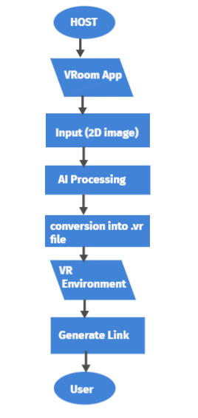
Idea:
The main objective of our project is to provide a real time environment to online meet.
The project provides a virtual Environment which uses the potential of Virtual Technology.
Once a person gets into our application, he will be asked to turn on his camera to train the exact environment and it is converted into VR environment.
The users in the meet can experience the real time environment while joining the vroom meet. (eg: classroom, industry etc.)
Initial Prototype Video link : https://youtu.be/Eg1aGtEaFHk
Highlights:
This can be adaptable to others sectors such as healthcare, architecture and Law Enforcement.
HARDWARE REQUIREMENTS:
Integrated Webcam
VR Box
SOFTWARE REQUIREMENTS:
Unity/Unreal engine
Blender
Open CV
AWS

Slide 3
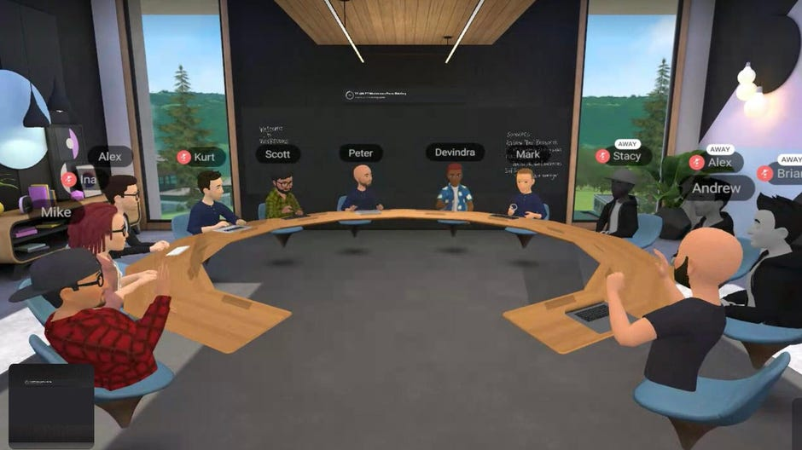
Use Cases:
Vroom App
Input environment through VR
.VR file
Rendering
Figure : 1.1 Our live virtual environment experienced through VR
Generate link
USER
Features:
Each user in the meet can able to simulate himself as a character in the VR world.
Vroom has a feature called automotive attendance system which works in a algorithm such that if a person attends the meet more than 70%, he will be marked as present.
For example, in a one hour meet if a person attends more than 42 minutes, he will be marked as present.
Host can customise his own environment easily as per his needs.
HOST
VR Environment
DEPENDENCIES:
Internet Connectivity.
A mobile device.
VR device (VR Box).

Slide 4
Team Member Details
Team Leader Name: Surya Narayanan CS
Branch : B.E Stream : ECE Year : II
Team Member 1 Name: Rithvikailas G
Branch : B.E Stream :ECE Year :II
Team Member 2 Name: Amiritavarshini S
Branch : B.E Stream: ECE Year : II
Team Member 3 Name: Harshini D A
Branch : B.E Stream : ECE Year : II
Team Member 4 Name: Abinanthan B
Branch : B.E Stream : ECE Year : I
Team Member 5 Name: Guruprasath M
Branch : B.E Stream: ECE Year : I
Team Mentor 1 Name: Mr. Anand
Category : Academic Expertise : AI/ML

